Slide 1

Working with Embeddings Part 1

Slide 2
Prem Jagyasi
“Your values are embedded within you irrespective of whether you discover them or not. Even if you never find them, they still govern your life.”

Slide 3



Notes:
https://www.youtube.com/channel/UC35ZpwldGw7ZJ5R-2sLijzw

Slide 4

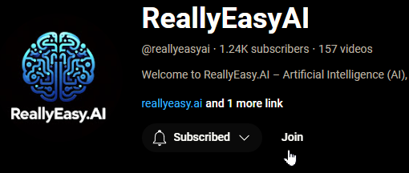
Membership has its privileges
Notes:
https://www.youtube.com/channel/UC35ZpwldGw7ZJ5R-2sLijzw/join

Slide 5
What is RAG?
Using Your Authoritative Sources

Slide 6
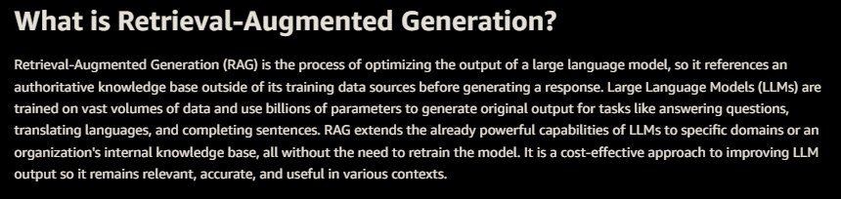
Notes:
https://aws.amazon.com/what-is/retrieval-augmented-generation/

Slide 7
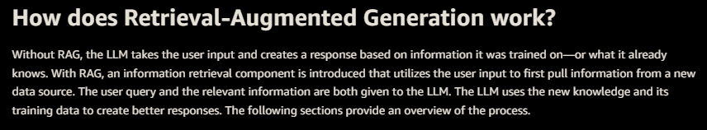
Notes:
https://aws.amazon.com/what-is/retrieval-augmented-generation/

Slide 8
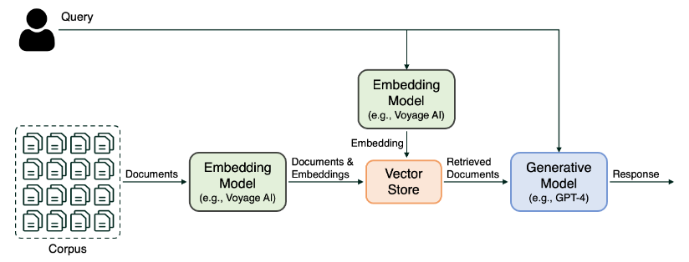
Classic RAG Approach

Slide 9
Understanding Embeddings
Vectors Are Your Friend
Notes:
https://platform.openai.com/docs/api-reference/files

Slide 10
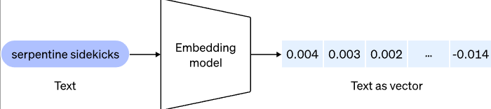
What Embedding Does

Slide 11
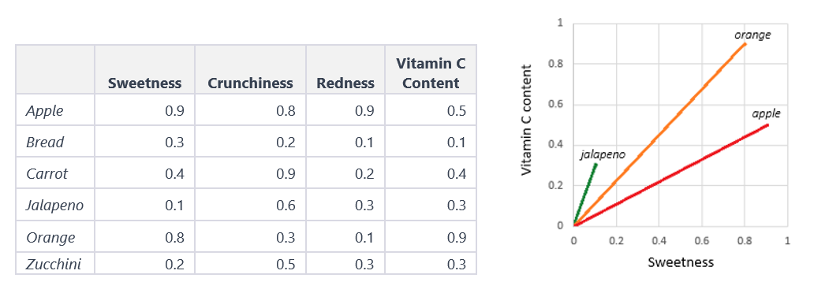
Notes:
https://insight.factset.com/ai-quick-bite-embeddings-and-large-language-models

Slide 12
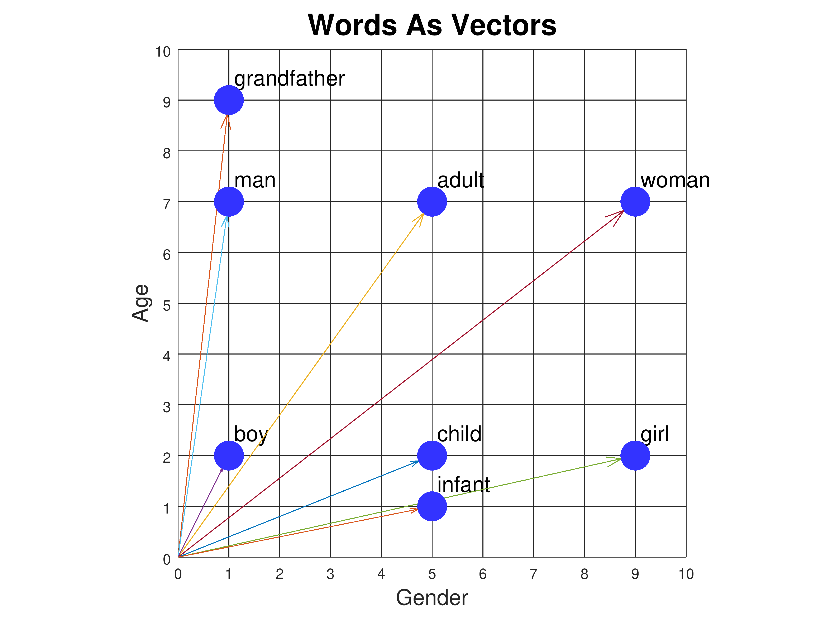
Notes:
https://www.cs.cmu.edu/~dst/WordEmbeddingDemo/tutorial.html

Slide 13
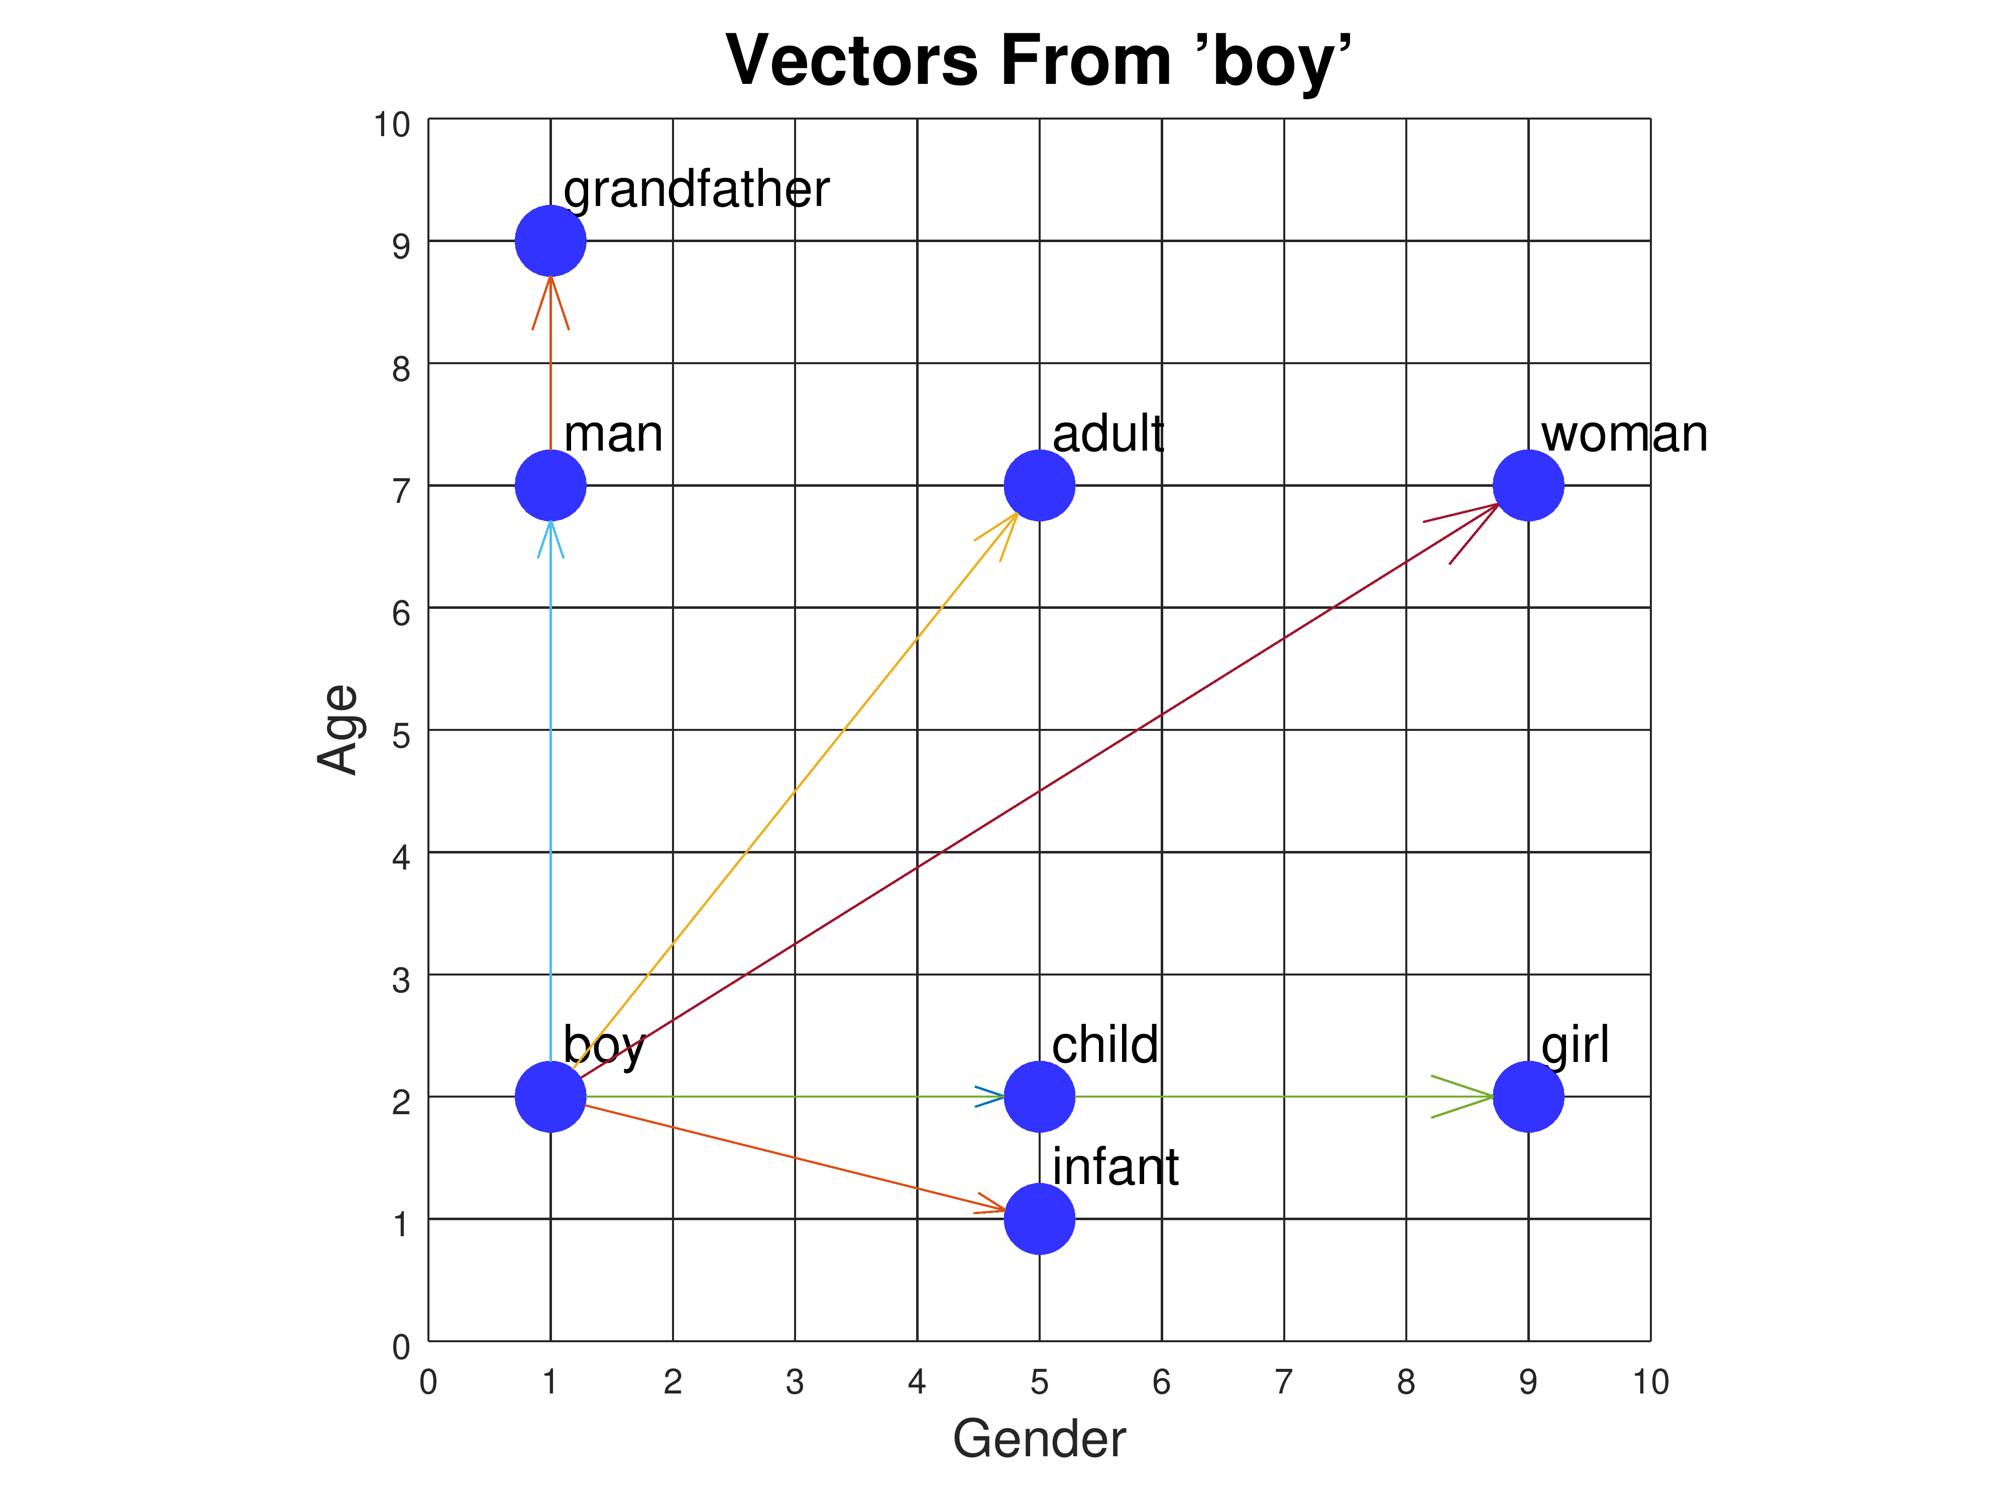
Notes:
https://www.cs.cmu.edu/~dst/WordEmbeddingDemo/tutorial.html

Slide 14
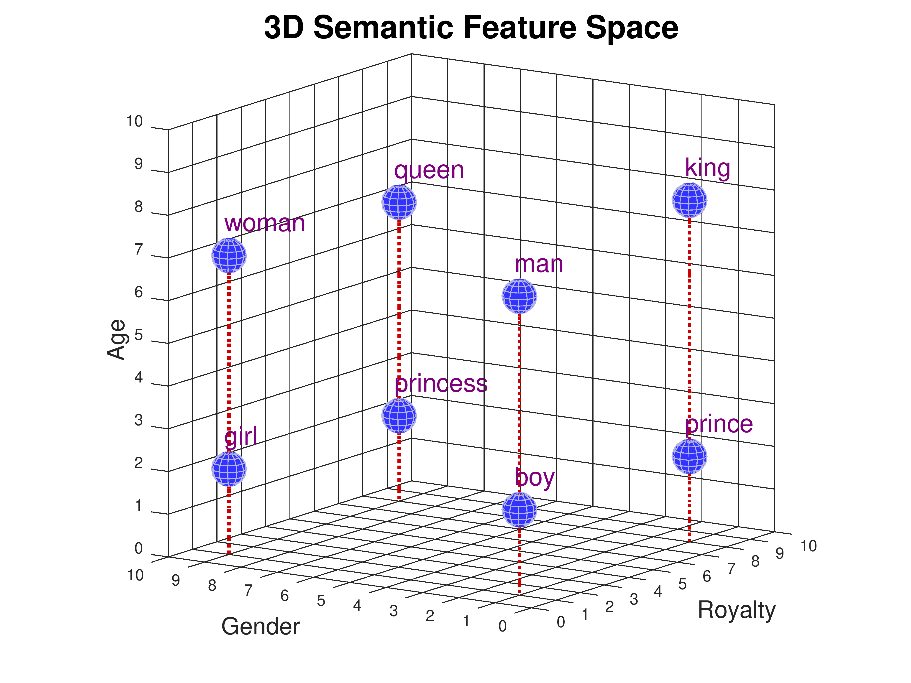
Notes:
https://www.cs.cmu.edu/~dst/WordEmbeddingDemo/tutorial.html

Slide 15
What Can I Use Embedding For?
1. Word relationships: Find words that are closely related or similar in meaning.
2. Text categorization: Understand the content and meaning of text to categorize it into different topics or sentiments.
3. Search improvements: Make search results more accurate by understanding the meaning behind search queries and documents.
4. Language translation: Improve the quality of translated text by understanding the relationships between words in different languages.
5. Text creation: Generate human-like text that stays on topic and makes sense in the given context.
6. Named entity identification: Better identify and classify names of people, places, and organizations within text.
7. Text summarization: Automatically create short summaries of long documents by identifying the most important information.
8. Personalized recommendations: Suggest items or content that a user might like based on their preferences and the item's characteristics.

Slide 16
Demo: Embedding “Mary”
# Create an embedding for the word "Mary" using the text-embedding-3-small model
response_small = client.embeddings.create(
input="Mary",
model="text-embedding-3-small"
)
# Create an embedding for the word "Mary" using the text-embedding-3-large model
response_large = client.embeddings.create(
input="Mary",
model="text-embedding-3-large"
)

Slide 17
Understanding Multidimensional Space
In the context of machine learning and specifically in the use of embeddings, the dimensionality of an embedding refers to the number of elements in the vector that represents the data point. Here, "Mary" is represented as a vector in a 1536-dimensional space when using the "text-embedding-3-small" model and as a 3072-dimensional vector with the "text-embedding-3-large" model.
The dimensions in an embedding vector come from the model that is used to generate them. These models are trained to capture various aspects of the data (like semantic meaning, context, syntax, etc.) and each dimension contributes some information about the data point in the high-dimensional space.
So, in simple terms, "Mary" is represented by a point in a 1536-dimensional space in the first model, and a different point in a 3072-dimensional space in the second model. These high-dimensional spaces are designed to capture a wide range of linguistic properties, allowing similar words or phrases to have similar embeddings (i.e., to be closer in that space), which is valuable for many natural language processing tasks.

Slide 18
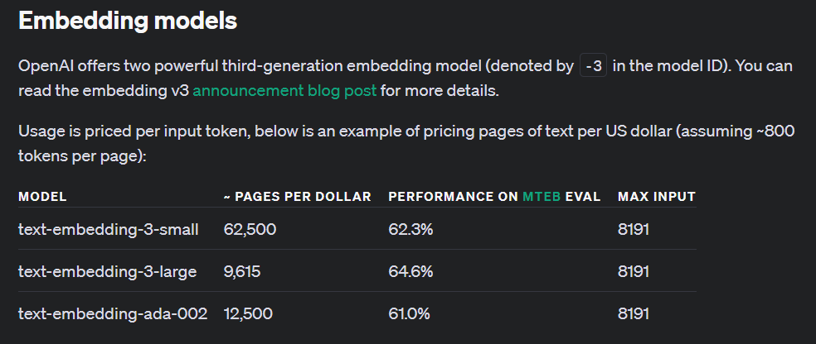
Notes:
https://platform.openai.com/docs/guides/embeddings/embedding-models

Slide 19

Notes:
https://github.com/embeddings-benchmark/mteb

Slide 20


